Slide 1
Spelling Correction: Edit Distance
Pawan Goyal
CSE, IITKGP
Week 2: Lecture 1
Spelling Correction: Edit Distance
Week 2: Lecture 1
1 / 20

Slide 2
Spelling Correction
I am writing this email on behaf of ...
The user typed ‘behaf’.
Which are some close words?
behalf
behave
....
Isolated word error correction
Pick the one that is closest to ‘behaf’
How to define ‘closest’? Need a distance metric
The simplest metric: edit distance
Spelling Correction: Edit Distance
Week 2: Lecture 1
2 / 20

Slide 3
Edit Distance
The minimum edit distance between two strings Is the minimum number of editing operations
⁾ Insertion
⁾ Deletion
⁾ Substitution
Spelling Correction: Edit Distance
Week 2: Lecture 1
3 / 20

Slide 4

Minimum Edit Distance
Example
Edit distance from ‘intention’ to ‘execution’
Spelling Correction: Edit Distance
Week 2: Lecture 1
4 / 20

Slide 5
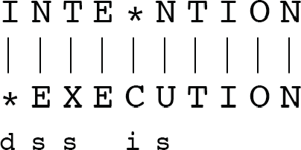
Minimum Edit Distance
If each operation has a cost of 1 (Levenshtein)
⁾ Distance between these is 5
If substitution costs 2 (alternate version)
⁾ Distance between these is 8
Spelling Correction: Edit Distance
Week 2: Lecture 1
5 / 20

Slide 6
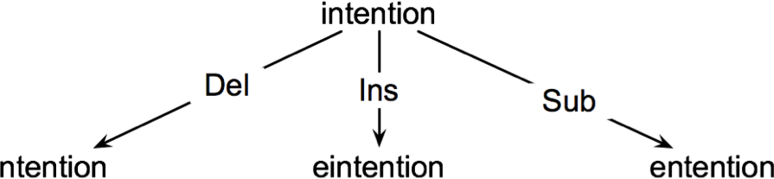
How to find the Minimum Edit Distance?
Searching for a path (sequence of edits) from the start string to the final string:
Initial state: the word we are transforming
Operators: insert, delete, substitute
Goal state: the word we are trying to get to
Path cost: what we want to minimize: the number of edits
Spelling Correction: Edit Distance
Week 2: Lecture 1
6 / 20

Slide 7
Minimum Edit as Search
How to navigate?
The space of all edit sequences is huge
Lot of distinct paths end up at the same state Don’t have to keep track of all of them
Keep track of the shortest path to each state
Spelling Correction: Edit Distance
Week 2: Lecture 1
7 / 20

Slide 8
Defining Minimum Edit Distance Matrix
For two strings
X of length n Y of length m
We define D(i, j)
the edit distance between X[1..i] and Y[1..j]
i.e., the first i characters of X and the first j characters of Y
Thus, the edit distance between X and Y is D(n, m)
Spelling Correction: Edit Distance
Week 2: Lecture 1
8 / 20

Slide 9
Computing Minimum Edit Distance
Dynamic Programming
A tabular computation of D(n, m)
Solving problems by combining solutions to subproblems Bottom-up
⁾ Compute D(i, j) for small i, j
⁾ Compute larger D(i, j) based on previously computed smaller values
⁾ Compute D(i, j) for all i and j till you get to D(n, m)
Spelling Correction: Edit Distance
Week 2: Lecture 1
9 / 20

Slide 10
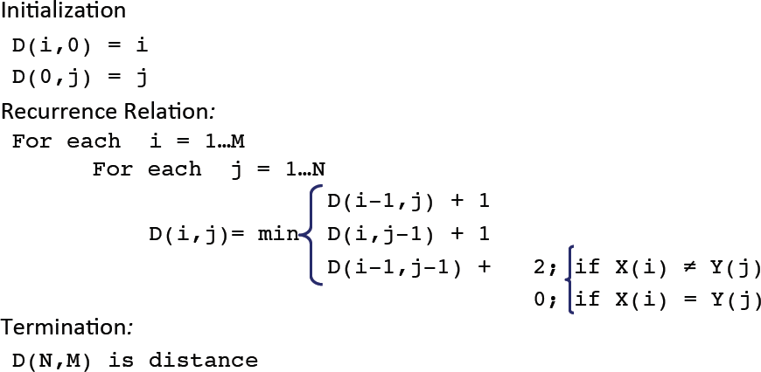
Dynamic Programming Algorithm
Spelling Correction: Edit Distance
Week 2: Lecture 1

Slide 11
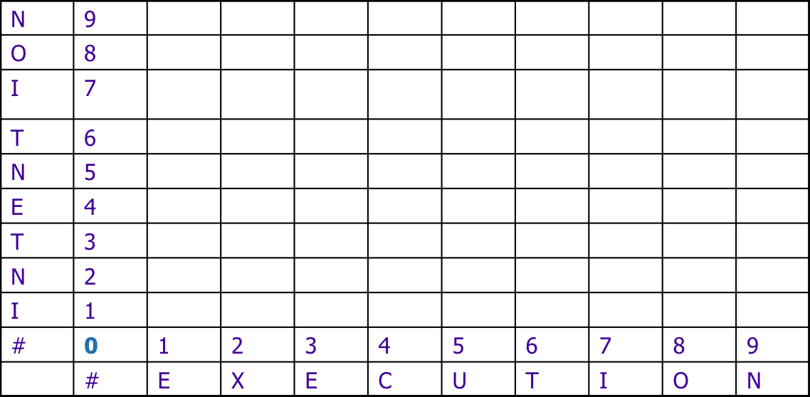
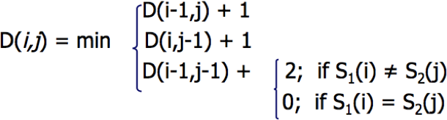
The Edit Distance Table
Spelling Correction: Edit Distance
Week 2: Lecture 1
11 / 20

Slide 12
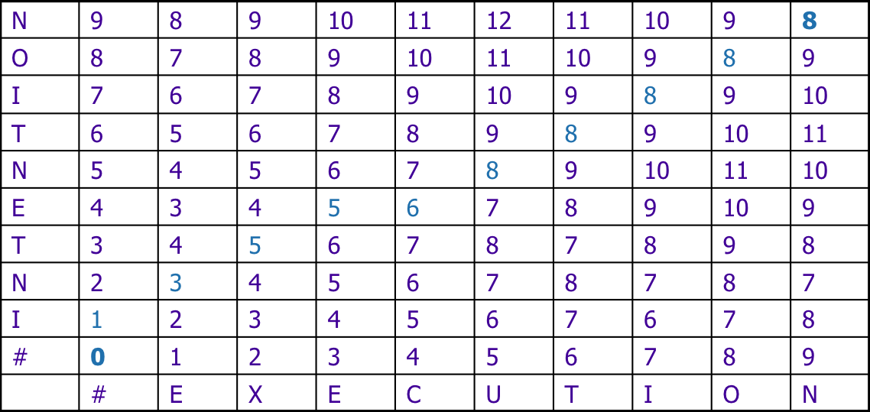
The Edit Distance Table
Spelling Correction: Edit Distance
Week 2: Lecture 1

Slide 13
Computing Alignments
Computing edit distance may not be sufficient for some applications
⁾ We often need to align characters of the two strings to each other
We do this by keeping a “backtrace”
Every time we enter a cell, remember where we came from When we reach the end,
⁾ Trace back the path from the upper right corner to read off the alignment
Spelling Correction: Edit Distance
Week 2: Lecture 1
13 / 20

Slide 14
The Edit Distance Table
Spelling Correction: Edit Distance
Week 2: Lecture 1

Slide 15
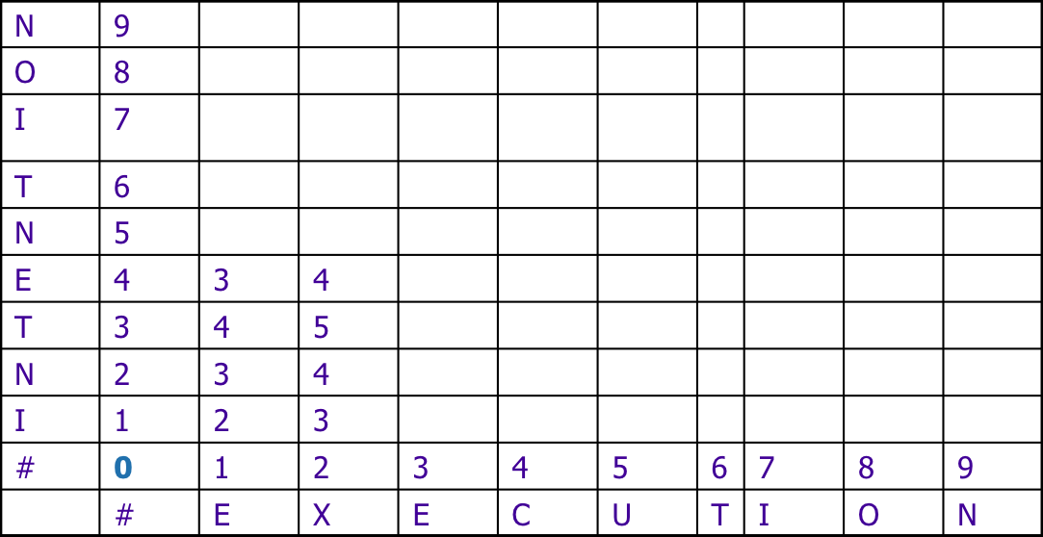
The Edit Distance Table
Spelling Correction: Edit Distance
Week 2: Lecture 1

Slide 16
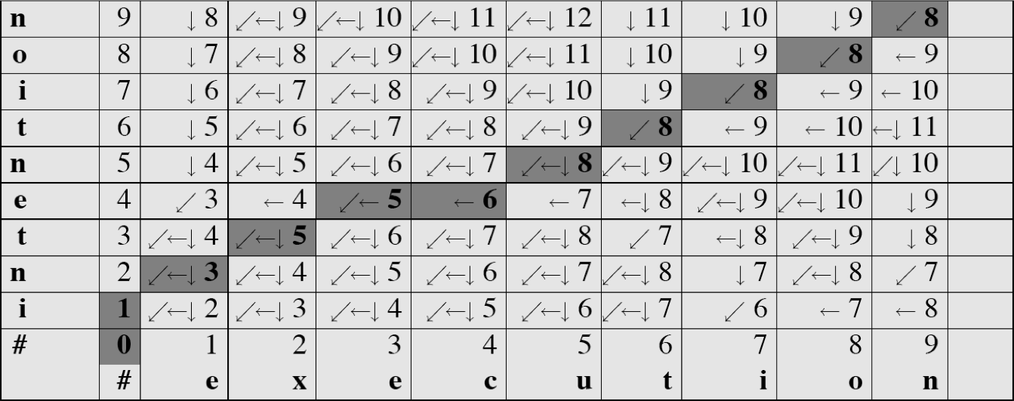
Minimum Edit with Backtrace
Spelling Correction: Edit Distance
Week 2: Lecture 1

Slide 17
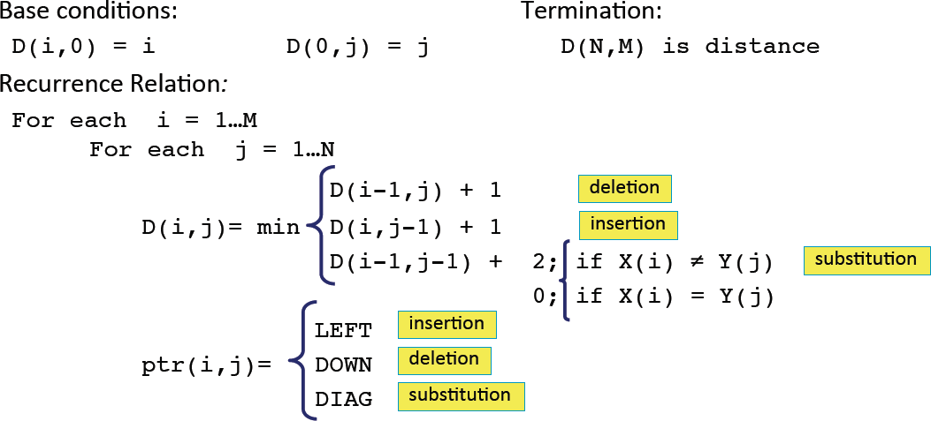
Adding Backtrace to Minimum Edit
Spelling Correction: Edit Distance
Week 2: Lecture 1

Slide 18
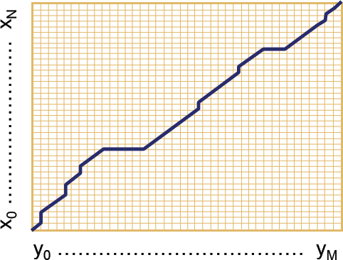
The distance matrix
Every non-decreasing path from (0,0) to (M,N) corresponds to an alignment of two sequences.
An optimal alignment is composed of optimal sub-alignments.
Spelling Correction: Edit Distance
Week 2: Lecture 1
18 / 20

Slide 19
Result of Backtrace
Spelling Correction: Edit Distance
Week 2: Lecture 1

Slide 20
Time O(nm)
Performance
Space O(nm)
Backtrace O(n + m)
Spelling Correction: Edit Distance
Week 2: Lecture 1
20 / 20

Slide 21
Weighted Edit Distance, Other variations
Pawan Goyal
CSE, IITKGP
Week 2: Lecture 2
Weighted Edit Distance, Other variations
Week 2: Lecture 2
1 / 12

Slide 22
Weighted Edit Distance
Why to add weights to the computation?
Some letters are more likely to be mistyped.
Weighted Edit Distance, Other variations
Week 2: Lecture 2
2 / 12

Slide 23
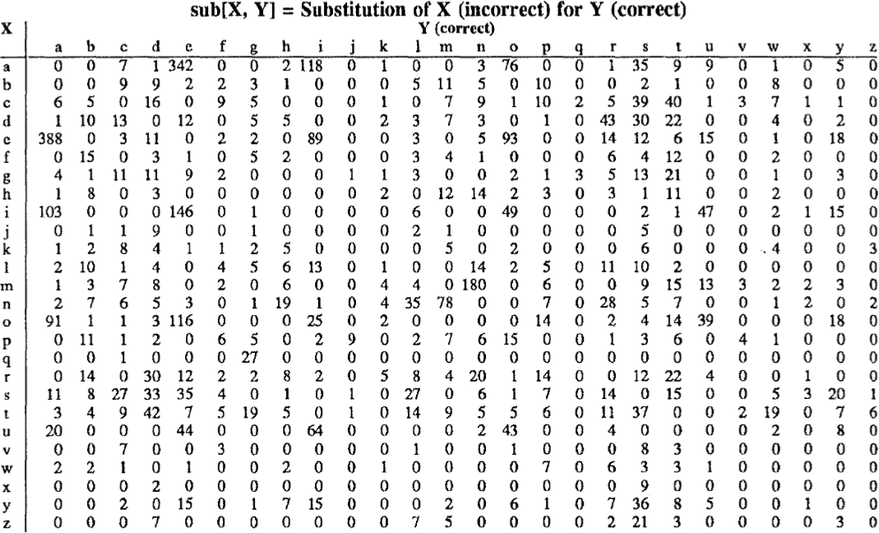
Confusion Matrix for Spelling Errors
Weighted Edit Distance, Other variations
Week 2: Lecture 2
3 / 12

Slide 24
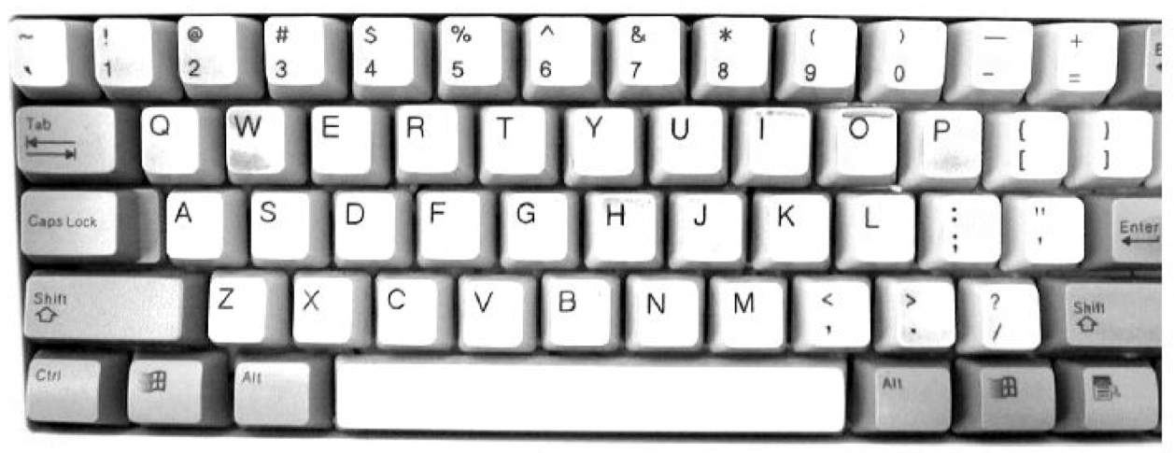
Keyboard Design
Weighted Edit Distance, Other variations
Week 2: Lecture 2
4 / 12

Slide 25
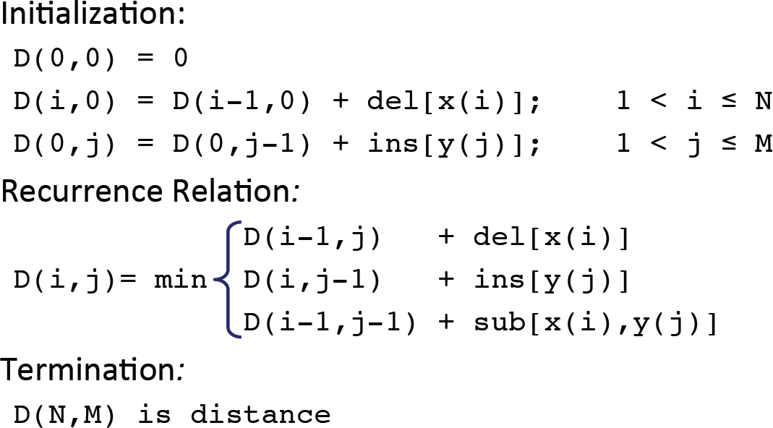
Weighted Minimum Edit Distance
Weighted Edit Distance, Other variations
Week 2: Lecture 2
5 / 12

Slide 26
How to modify the algorithm with transpose?
Transpose
transpose(x, y) = (y, x)
Also known as metathesis
Modification to the dynamic programmic algorithm
D(i − 1, j) + 1 (deletion)

D(i, j − 1) + 1 (insertion)

(

1 if (x[i] /= y[j])(substitution)
D[i][j] = min D(i − 1, j − 1)+
0 otherwise

D(i − 2, j − 2) + 1
(x[i] = y[j − 1] and x[i − 1] = y[j]

(transposition)
Weighted Edit Distance, Other variations
Week 2: Lecture 2
6 / 12

Slide 27
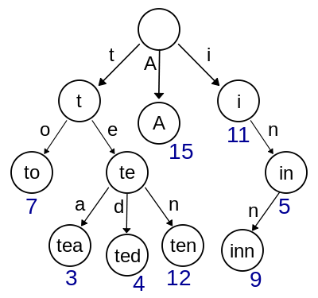
How to find dictionary entries with smallest edit distance?
Naïve Method
Compute edit ditance from the query term to each dictionary term – an exhaustive search
Can be made efficient if we do it over a trie structure
Weighted Edit Distance, Other variations
Week 2: Lecture 2
7 / 12

Slide 28
How to find dictionary entries with smallest edit distance?
Generate all possible terms with an edit distance <=2 (deletion + transpose + substitution + insertion) from the query term and search them in the dictionary.
For a word of length 9, alphabet of size 36, this will lead to 114,324 terms to search for
For Chinese alphabet size is 70,000 (Unicode Han Characters)
Weighted Edit Distance, Other variations
Week 2: Lecture 2
8 / 12

Slide 29
How to find dictionary entries with smallest edit distance?
Symmetric Delete Spelling Correction
Generate terms with an edit distance ≤ 2 (deletes) from each dictionary term (offline)
Generate terms with an edit distance ≤ 2 (deletes) from the input terms and search in dictionary
Number of deletes within edit distance ≤ 2 for a word of length 9 will be 45
A further check is required to remove the false positives
Weighted Edit Distance, Other variations
Week 2: Lecture 2
9 / 12

Slide 30
Spelling Correction
Types of spelling errors: Non-word Errors
behaf → behalf
Types of spelling errors: Real-word Errors
Typographical errors: three → there
Cognitive errors (homophones): piece → peace, too → two
Weighted Edit Distance, Other variations
Week 2: Lecture 2
10 / 12

Slide 31
Non-word spelling errors
Non-word spelling error detection
Any word not in a dictionary is an error The larger the dictionary the better
Non-word spelling error correction
Generate candidates: real words that are similar to the error word Choose the best one:
⁾ Shortest weighted edit distance
⁾ Highest noisy channel probabliity
Weighted Edit Distance, Other variations
Week 2: Lecture 2
11 / 12

Slide 32
Real word spelling errors
For each word w, generate candidate set
Find candidate words with similar pronunciations Find candidate words with similar spelling Include w in candidate set
Choosing best candidate
Noisy Channel
Weighted Edit Distance, Other variations
Week 2: Lecture 2
12 / 12

Slide 33
Noisy Channel Model for Spelling Correction
Pawan Goyal
CSE, IITKGP
Week 2: Lecture 3
Noisy Channel Model for Spelling Correction
Week 2: Lecture 3
1 / 17

Slide 34
Noisy Channel
We see an observation x of the misspelled word
Find the correct word w
wˆ = argmaxP(w|x)
w∈V
_{= argmax} P(x|w)P(w)
w∈V
P(x)
= argmaxP(x|w)P(w)
w∈V
Noisy Channel Model for Spelling Correction
Week 2: Lecture 3
2 / 17

Slide 35
Non-word spelling error: acress
Words with similar spelling
Small edit distance to error
Words with similar pronuncitation
Small edit distance of pronunciation to error
Damerau-Levenshtein edit distance Minimum edit distance, where edits are: Insertion, Deletion, Substitution, Transposition of two adjacent letters
Noisy Channel Model for Spelling Correction
Week 2: Lecture 3
3 / 17

Slide 36
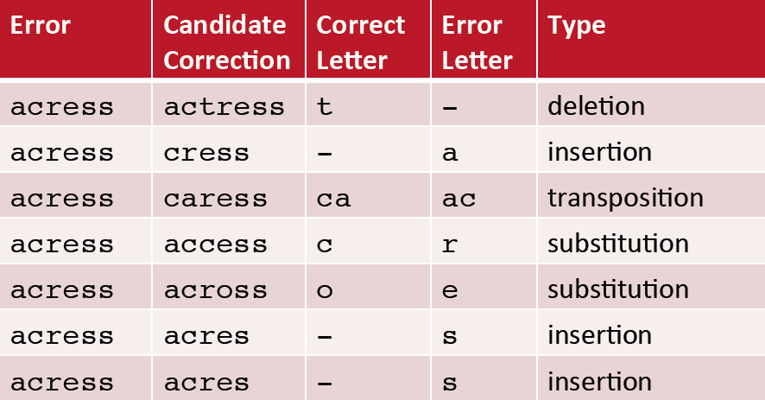
Words within edit distance 1 of acress
Noisy Channel Model for Spelling Correction
Week 2: Lecture 3
4 / 17

Slide 37
Candidate generation
80% of errors are within edit distance 1 Almost all errors within edit distance 2
Allow deletion of space or hyphen
thisidea → this idea inlaw → in-law
Noisy Channel Model for Spelling Correction
Week 2: Lecture 3
5 / 17

Slide 38
Computing error probability: confusion matrix
del[x,y]: count (xy typed as x) ins[x,y]: count (x typed as xy) sub[x,y]: count (x typed as y) trans[x,y]: count(xy typed as yx)
Insertion and deletion are conditioned on previous character
Noisy Channel Model for Spelling Correction
Week 2: Lecture 3
6 / 17

Slide 39
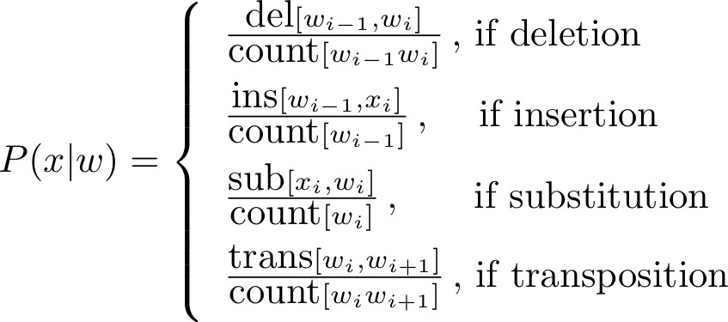
Channel model
Noisy Channel Model for Spelling Correction
Week 2: Lecture 3
7 / 17

Slide 40
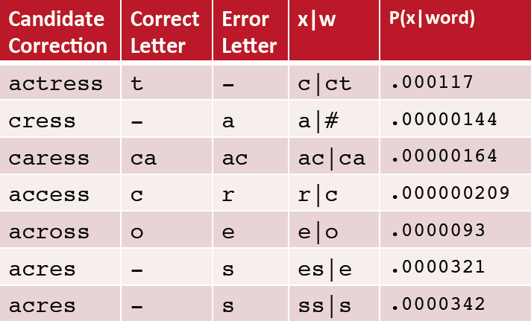
Channel model for acress
Noisy Channel Model for Spelling Correction
Week 2: Lecture 3
8 / 17

Slide 41
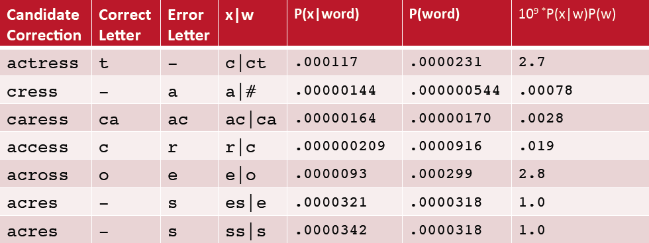
Noisy channel probability for acress
Noisy Channel Model for Spelling Correction
Week 2: Lecture 3
9 / 17

Slide 42
Using a bigram language model
“ ... versatile acress whose ...”
Counts from the Corpus of Contemporary American English with add-1 smoothing
P(actress|versatile) = 0.000021, P(across|versatile) = 0.000021
P(whose|actress) = 0.0010, P(whose|across) = 0.000006 P(“versatile actress whose”) = 0.000021 * 0.0010 = 210 x 10⁻¹⁰ P(“versatile across whose”) = 0.000021 * 0.000006 = 1 x10⁻¹⁰
Noisy Channel Model for Spelling Correction
Week 2: Lecture 3
10 / 17

Slide 43
Real-word spelling errors
The study was conducted mainly be John Black The design an construction of the system ...
25-40% of spelling errors are real words
Noisy Channel Model for Spelling Correction
Week 2: Lecture 3
11 / 17

Slide 44
Noisy channel for real-word spell correction
Given a sentence X = w₁, w₂, w₃ . . . , w_{n} Candidate (w₁) = {w₁, w′₁, w′′₁, w′′′₁, . . .} Candidate (w₂) = {w₂, w′₂, w′′₂, w′′′₂, . . .} Candidate (w₃) = {w₃, w′₃, w′′₃, w′′′₃, . . .}
Choose the sequence W that maximizes P(W|X)
Noisy Channel Model for Spelling Correction
Week 2: Lecture 3
12 / 17

Slide 45
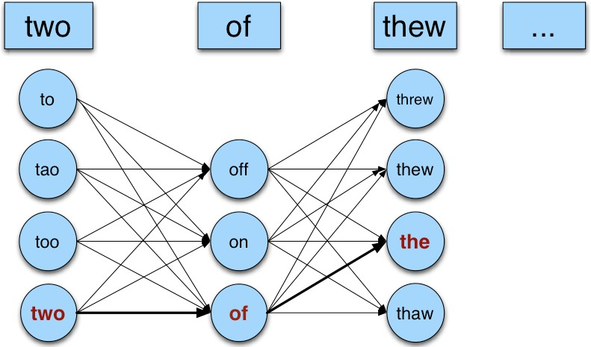
Noisy channel for real-world spell correction
Noisy Channel Model for Spelling Correction
Week 2: Lecture 3

Slide 46
Simplification: One error per sentence
Choose among all possible sentences with one word replaced
two of thew
w₁, w′′₂, w₃ two off thew w₁, w₂, w′₃ two of the w′′′₁, w₂, w₃ too of thew
Choose the sequence W that maximizes P(W|X)
Noisy Channel Model for Spelling Correction
Week 2: Lecture 3
14 / 17

Slide 47
Getting the probability values
Noisy Channel
W^{ˆ} = argmaxP(W|X)
W∈S
where X is the observed sentence and S is the set of all the possible sequences from the candidate set
= argmaxP(X|W)P(W)
W∈S
P(X|W)
Same as for non-word spelling correction Also require proabability for no error P(w|w)
Noisy Channel Model for Spelling Correction
Week 2: Lecture 3
15 / 17

Slide 48
Probability of no error
What is the probability for a correctly typed word? P(“the”|“the”)
It may depend on the source text under consideration
1 error in 10 words → 0.9
1 error in 100 words → 0.99
Noisy Channel Model for Spelling Correction
Week 2: Lecture 3
16 / 17

Slide 49
Computing P(W)
Use Language Model
Unigram Bigram
...
Noisy Channel Model for Spelling Correction
Week 2: Lecture 3
17 / 17

Slide 50
N-gram Language Models
Pawan Goyal
CSE, IITKGP
Week 2: Lecture 4
N-gram Language Models
Week 2: Lecture 4
1 / 24

Slide 51
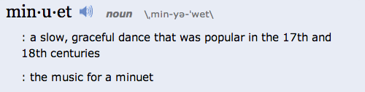
Context Sensitive Spelling Correction
The office is about fifteen minuets from my house
Use a Language Model
P(about fifteen minutes from) > P(about fifteen minuets from)
N-gram Language Models
Week 2: Lecture 4
2 / 24

Slide 52
Probablilistic Language Models: Applications
Speech Recognition
P(I saw a van) >> P(eyes awe of an)
Machine Translation
Which sentence is more plausible in the target language?
P(high winds) > P(large winds)
Other Applications
Context Sensitive Spelling Correction Natural Language Generation
...
N-gram Language Models
Week 2: Lecture 4
3 / 24

Slide 53
Completion Prediction
Language model also supports predicting the completion of a sentence.
⁾ Please turn off your cell ...
⁾ Your program does not ...
Predictive text input systems can guess what you are typing and give choices on how to complete it.
N-gram Language Models
Week 2: Lecture 4
4 / 24

Slide 54
Probabilistic Language Modeling
Goal: Compute the probability of a sentence or sequence of words:
P(W) = P(w₁, w₂, w₃,..., w_{n})
Related Task: probability of an upcoming word:
P(w₄|w₁, w₂, w₃)
A model that computes either of these is called a language model
N-gram Language Models
Week 2: Lecture 4
5 / 24

Slide 55
Computing P(W)
How to compute the joint probability
P(about, fifteen, minutes, from)
Basic Idea
Rely on the Chain Rule of Probability
N-gram Language Models
Week 2: Lecture 4
6 / 24

Slide 56
The Chain Rule
Conditional Probabilities
P(A, B)
P(B|A) =
P(A)
P(A, B) = P(A)P(B|A)
More Variables
P(A, B, C, D) = P(A)P(B|A)P(C|A, B)P(D|A, B, C)
The Chain Rule in General
P(x₁, x₂, . . . , x_{n}) = P(x₁)P(x₂|x₁)P(x₃|x₁, x₂) . . . P(x_{n}|x₁,..., x_{n−1})
N-gram Language Models
Week 2: Lecture 4
7 / 24

Slide 57
Probability of words in sentences
P(w₁w₂ . . . w_{n}) = ∏P(w_{i}|w₁w₂ . . . w_{i−1})
i
P(“about fifteen minutes from”) =
P(about) x P(fifteen | about) x P(minutes | about fifteen) x P(from | about fifteen minutes)
N-gram Language Models
Week 2: Lecture 4
8 / 24

Slide 58
Estimating These Probability Values
Count and divide
P(office | about fifteen minutes from) = Count (about fifteen minutes from office)
Count (about fifteen minutes from)
What is the problem
We may never see enough data for estimating these
N-gram Language Models
Week 2: Lecture 4
9 / 24

Slide 59
Markov Assumption
Simplifying Assumption: Use only the previous word
P(office | about fifteen minutes from) ≈ P(office | from)
Or the couple previous words
P(office | about fifteen minutes from) ≈ P(office | minutes from)
N-gram Language Models
Week 2: Lecture 4
10 / 24

Slide 60
Markov Assumption
More Formally: kth order Markov Model
Chain Rule:
P(w₁w₂ . . . w_{n}) = ∏P(w_{i}|w₁w₂ . . . w_{i−1})
i
Using Markov Assumption: only k previous words
P(w₁w₂ . . . w_{n}) ≈ ∏P(w_{i}|w_{i−k} . . . w_{i−1})
i
We approximate each component in the product
P(w_{i}|w₁w₂ . . . w_{i−1}) ≈ P(w_{i}|w_{i−k} . . . w_{i−1})
N-gram Language Models
Week 2: Lecture 4
11 / 24

Slide 61
N-Gram Models
P(office | about fifteen minutes from)
An N-gram model uses only N − 1 words of prior context.
Unigram: P(office) Bigram: P(office | from)
Trigram: P(office | minutes from)
Markov model and Language Model
An N-gram model is an N − 1-order Markov Model
N-gram Language Models
Week 2: Lecture 4
12 / 24

Slide 62
N-Gram Models
We can extend to trigrams, 4-grams, 5-grams In general, an insufficient model of language:
language has long-distance dependencies:
“The computer which I had just put into the machine room on the fifth floor crashed.”
In most of the applications, we can get away with N-gram models
N-gram Language Models
Week 2: Lecture 4
13 / 24

Slide 63
Estimating N-grams probabilities
Maximum Likelihood Estimate
Value that makes the observed data the “most probable”
count(w , w )
P(w |w ) =
i−1 i
i i−1
count(w_{i−1})
c(w , w )
P(w |w ) =
i−1 i
i i−1
c(w_{i−1})
N-gram Language Models
Week 2: Lecture 4
14 / 24

Slide 64
An Example
<s>I am here </s>
<s>who am I </s>
<s>I would like to know </s>
c(w , w )
P(w_{i}|w_{i−1}) =
Estimating bigrams
i−1 i
c(w_{i−1})
P(I|<s>) = 2/3
P(</s>|here) =1 P(would | I) = 1/3 P(here | am) = 1/2 P(know | like) = 0
N-gram Language Models
Week 2: Lecture 4
15 / 24

Slide 65
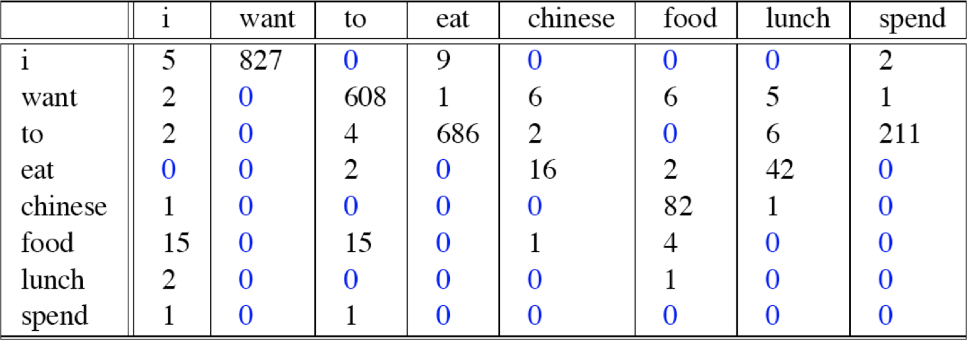
Bigram counts from 9222 Restaurant Sentences
N-gram Language Models
Week 2: Lecture 4

Slide 66
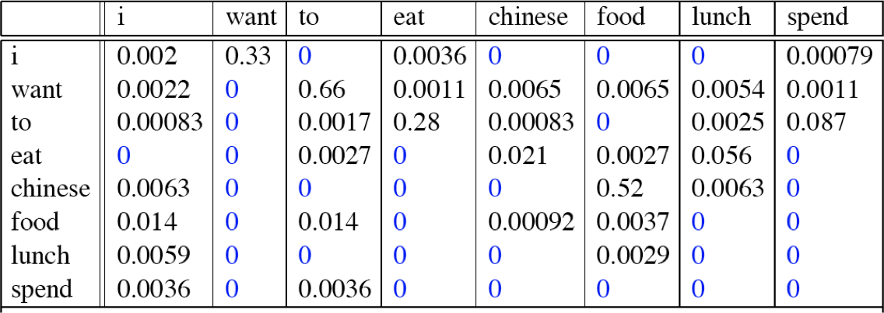
Computing bigram probabilities
Normlize by unigrams
Bigram Probabilities
N-gram Language Models
Week 2: Lecture 4
17 / 24

Slide 67
Computing Sentence Probabilities
P(<s> I want english food </s>)
= P(I | <s>) x P(want | I) x P(english | want) x P(food | english ) x P(</s> | food)
= 0.000031
N-gram Language Models
Week 2: Lecture 4
18 / 24

Slide 68
What knowledge does n-gram represent?
P(english|want) = .0011
P(chinese|want) = .0065
P(to|want) = .66 P(eat | to) = .28 P(food | to) = 0 P(want | spend) = 0 P (i | <s>) = .25
N-gram Language Models
Week 2: Lecture 4

Slide 69
Practical Issues
Everything in log space
Avoids underflow
Adding is faster than multiplying
log(p₁ × p₂ × p₃ × p₄) = logp₁ + logp₂ + logp₃ + logp₄
Handling zeros
Use smoothing
N-gram Language Models
Week 2: Lecture 4
20 / 24

Slide 70
Language Modeling Toolkit
SRILM
http://www.speech.sri.com/projects/srilm/
N-gram Language Models
Week 2: Lecture 4

Slide 71
Google N-grams
Number of tokens: 1,024,908,267,229 Number of sentences: 95,119,665,584 Number of unigrams: 13,588,391 Number of bigrams: 314,843,401 Number of trigrams: 977,069,902 Number of fourgrams: 1,313,818,354 Number of fivegrams: 1,176,470,663
http://googleresearch.blogspot.in/2006/08/ all-our-n-gram-are-belong-to-you.html
N-gram Language Models
Week 2: Lecture 4

Slide 72
Example from the 4-gram data
serve as the inspector 66 serve as the inspiration 1390 serve as the installation 136 serve as the institute 187 serve as the institution 279 serve as the institutional 461
N-gram Language Models
Week 2: Lecture 4

Slide 73
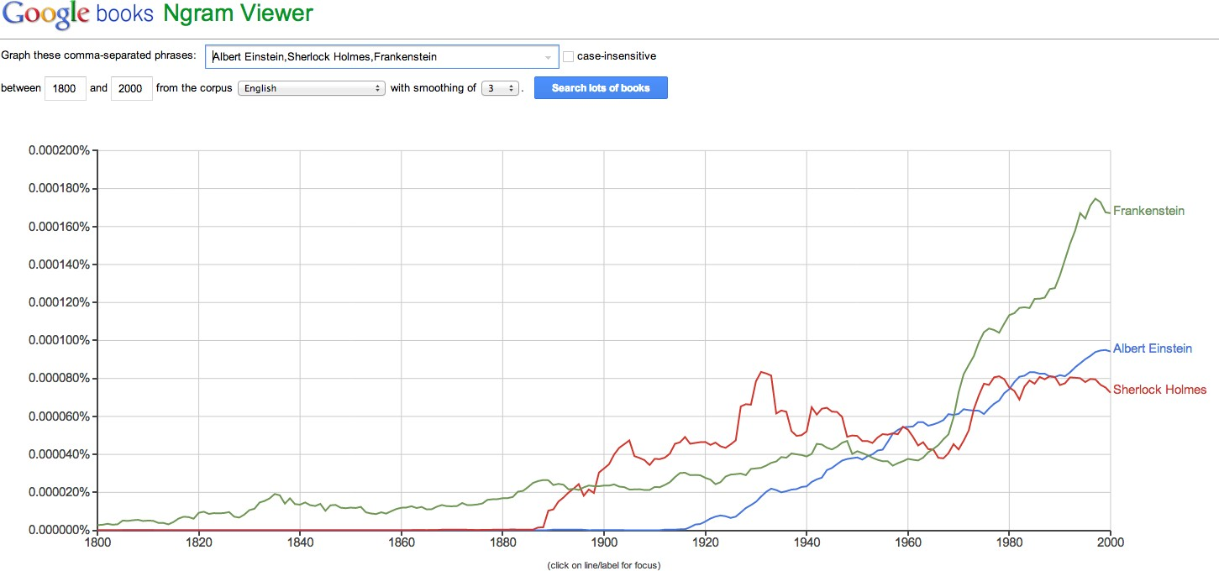
Google books Ngram Data
N-gram Language Models
Week 2: Lecture 4

Slide 74
Evaluation of Language Models, Basic Smoothing
Pawan Goyal
CSE, IITKGP
Week 2: Lecture 5
Evaluation of Language Models, Basic Smoothing
Week 2: Lecture 5
1 / 16

Slide 75
Evaluating Language Model
Does it prefer good sentences to bad sentences?
Assign higher probability to real (or frequently observed) sentences than ungrammatical (or rarely observed) ones
Training and Test Corpora
Parameters of the model are trained on a large corpus of text, called
training set.
Performance is tested on a disjoint (held-out) test data using an
evaluation metric
Evaluation of Language Models, Basic Smoothing
Week 2: Lecture 5
2 / 16

Slide 76
Extrinsic evaluation of N-grams models
Comparison of two models, A and B
Use each model for one or more tasks: spelling corrector, speech recognizer, machine translation
Get accuracy values for A and B Compare accuracy for A and B
Evaluation of Language Models, Basic Smoothing
Week 2: Lecture 5
3 / 16

Slide 77
Intrinsic evaluation: Perplexity
Intuition: The Shannon Game
How well can we predict the next word?
I always order pizza with cheese and . . . The president of India is . . .
I wrote a . . .
Unigram model doesn’t work for this game.
A better model of text
is one which assigns a higher probability to the actual word
Evaluation of Language Models, Basic Smoothing
Week 2: Lecture 5
4 / 16

Slide 78
Perplexity
The best language model is one that best predics an unseen test set
Perplexity (PP(W))
Perplexity is the inverse probability of the test data, normalized by the number of words:
PP(W) = P(w w . . . w )
−
1
N
1 2 N
Applying chain Rule
1
N
∏
1
PP(W) =
P(w |w . . . w )
i 1 i−1
For bigrams
1
N
∏
1
PP(W) =
P(w |w )
i i−1
Evaluation of Language Models, Basic Smoothing
Week 2: Lecture 5
5 / 16

Slide 79
Example: A Simple Scenario
Consider a sentence consisting of N random digits
Find the perplexity of this sentence as per a model that assigns a probability p = 1/10 to each digit.
PP(W) = P(w w . . . w )
−
1
N
1 2 N
! 1
N
N
−
1
=
10
1
−1
=
10
= 10
Evaluation of Language Models, Basic Smoothing
Week 2: Lecture 5
6 / 16

Slide 80
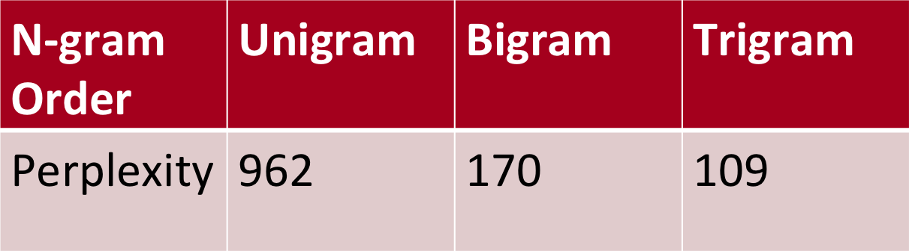
Lower perplexity = better model
WSJ Corpus
Training: 38 million words
Test: 1.5 million words
Unigram perplexity: 962?
The model is as confused on test data as if it had to choose uniformly and independently among 962 possibilities for each word.
Evaluation of Language Models, Basic Smoothing
Week 2: Lecture 5
7 / 16

Slide 81
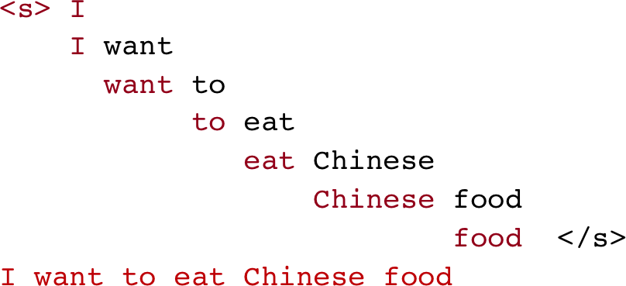
The Shannon Visualization Method
Use the language model to generate word sequences
Choose a random bigram (<s>,w) as per its probability
Choose a random bigram (w,x) as per its probability
And so on until we choose
</s>
Evaluation of Language Models, Basic Smoothing
Week 2: Lecture 5
8 / 16

Slide 82
Shakespeare as Corpus
N = 884,647 tokens, V = 29,066
Shakespeare produced 300,000 bigram types out of V² = 844 million possible bigrams.
Evaluation of Language Models, Basic Smoothing
Week 2: Lecture 5

Slide 83
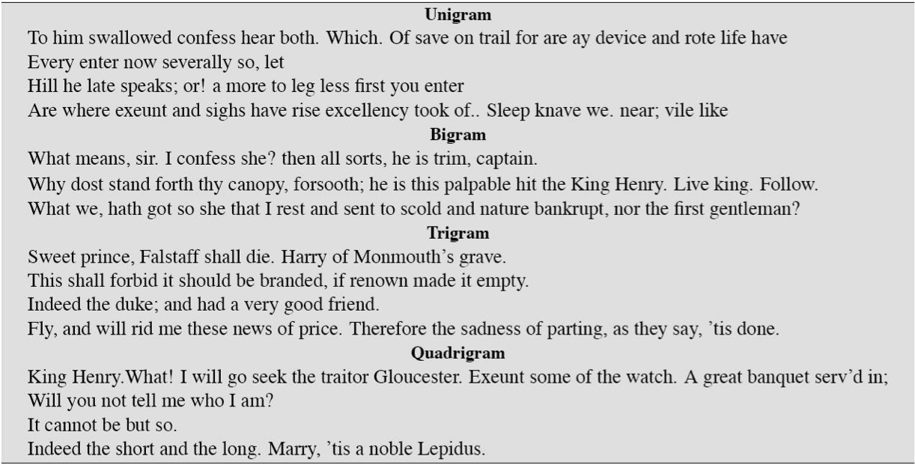
Approximating Shakespeare
Evaluation of Language Models, Basic Smoothing
Week 2: Lecture 5

Slide 84
Problems with simple MLE estimate: zeros
Training set
... denied the allegations
... denied the reports
... denied the claims
... denied the request
Test Data
... denied the offer
... denied the loan
Zero probability n-grams
P(offer | denied the) = 0
The test set will be assigned a probability 0 And the perplexity can’t be computed
Evaluation of Language Models, Basic Smoothing
Week 2: Lecture 5
11 / 16

Slide 85
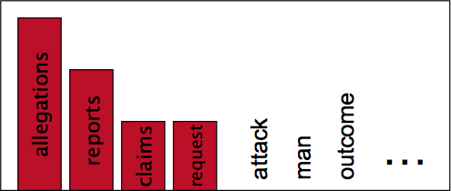
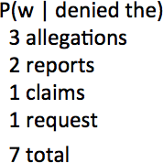
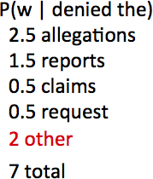
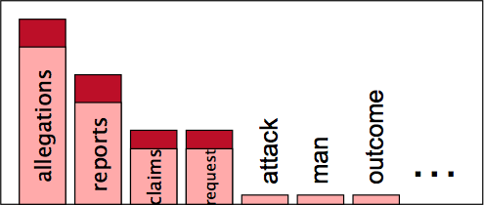
Language Modeling: Smoothing
With sparse statistics
Steal probability mass to generalize better
Evaluation of Language Models, Basic Smoothing
Week 2: Lecture 5
12 / 16

Slide 86
Laplace Smoothing (Add-one estimation)
Pretend as if we saw each word (N-gram) one more time that we actually did
Just add one to all the counts!
MLE estimate for bigram: P_{MLE}(w_{i}|w_{i−1}) =
c(w ,w )
i−1 i
c(w_{i−1})
Add-1 estimate: P_{Add−1}(w_{i}|w_{i−1}) =
c(w ,w )+1
i−1 i
c(w_{i−1})+V
Evaluation of Language Models, Basic Smoothing
Week 2: Lecture 5
13 / 16

Slide 87
Reconstituted counts as effect of smoothing
Effective bigram count (c∗(w_{n−1}w_{n}))
c∗(w_{n−1}w_{n}) ₌ c(w_{n−1}w_{n}) + 1 c(w_{n−1}) c(w_{n−1}) + V
Evaluation of Language Models, Basic Smoothing
Week 2: Lecture 5

Slide 88

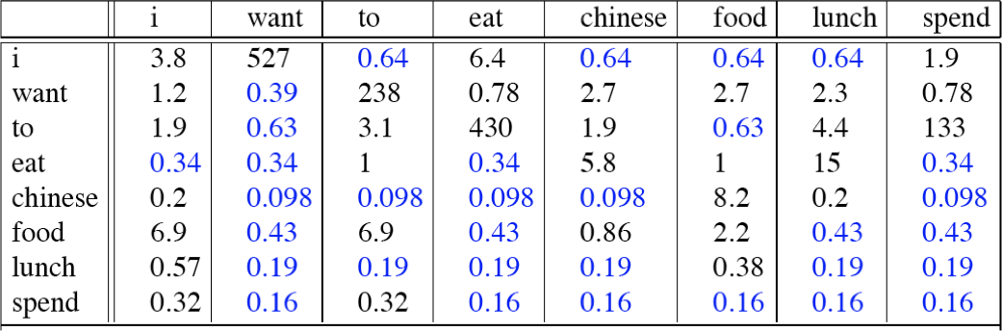
Comparing with bigrams: Restaurant corpus
Evaluation of Language Models, Basic Smoothing
Week 2: Lecture 5
15 / 16

Slide 89
More general formulations: Add-k
c(w ,
w ) + k
P
(w |w ) =
i−1 i
Add k
— i i−1
c(w_{i−1}) + kV
c(w_{i−1}, w_{i}) + m( ¹ )
PAdd−k(wi|wi−1) =
Unigram prior smoothing:
V
c(w_{i−1}) + m
c(w
, w ) + mP(w )
P (w |
w ) =
i−1 i
i
UnigramPrior i i−1
c(w_{i−1}) + m
A good value of k or m?
Can be optimized on held-out set
Evaluation of Language Models, Basic Smoothing
Week 2: Lecture 5
16 / 16

